Slide 1


UPCOMING INTERNATIONAL COMPETITIONS AND OLYMPIADS OFFERED BY TLUPS INDIA
Prepared by
Reshma Prasad

Slide 2

INDEX
Competitions offering
Preliminary round
Global round
How we will be helping the students t prepare
Course for attending the Global round

Slide 3
COMPETITIONS
Einstein Olympiad
TIMO ( Turkic International Mathematical Olympiad)
ADEPT ( Achievement in Diverse Educational Progress and Talent)
SIN Physics
Avogadro Chemistry
National Biology Competition

Slide 4

I. EINSTEIN OLYMPIAD
The Einstein Olympiad is an international academic competition founded by the Albert Einstein Global Academy in Berlin
It focuses on creativity, imagination, and innovative thinking rather than rote learning
Giving students from various countries an opportunity to showcase their scientific curiosity and problem-solving skills on a global stage.
To inspire young students in Science and Mathematics

Slide 5


EINSTEIN OLYMPIAD - OVERVIEW
Competition | Grade | No of questions | Duration (Minutes) | Marking Scheme | Total Marks | Negative Marking | Competition Date | Registration fee
Einstein Olympiad | 2nd -12th grade | 25 | 90 | +4 for correct, 0 for wrong, 0 for unanswered question | 100 | -1 | 15TH April 2026 | 650/-INR
Qualification thresholds for the Final
Gold – 91-100
Silver – 75-90
Bronze – 50- 74
Honorable Mention- 40-48
Participation – 1-39

Slide 6

GLOBAL ROUND - OVERVIEW
Competition | Grade | No of questions | Duration (Minutes) | Marking Scheme | Total Marks | Negative Marking | Competition Date
Einstein Olympiad- Global round | 2nd -12th grade | 25 | 120 | +4 for correct, 0 for wrong, 0 for unanswered question | 100 | -1 | 5-8th of October 2026
More advanced and creative problem-solving questions; may include additional challenge rounds
Students receive world ranking based on final round performance
If students score the same, a tiebreaker system is applied

Slide 7
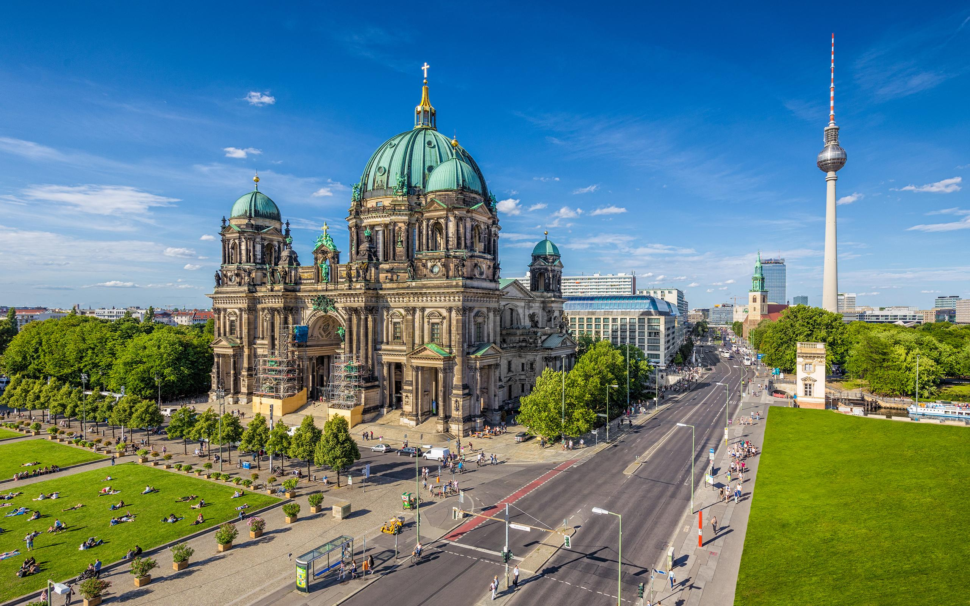
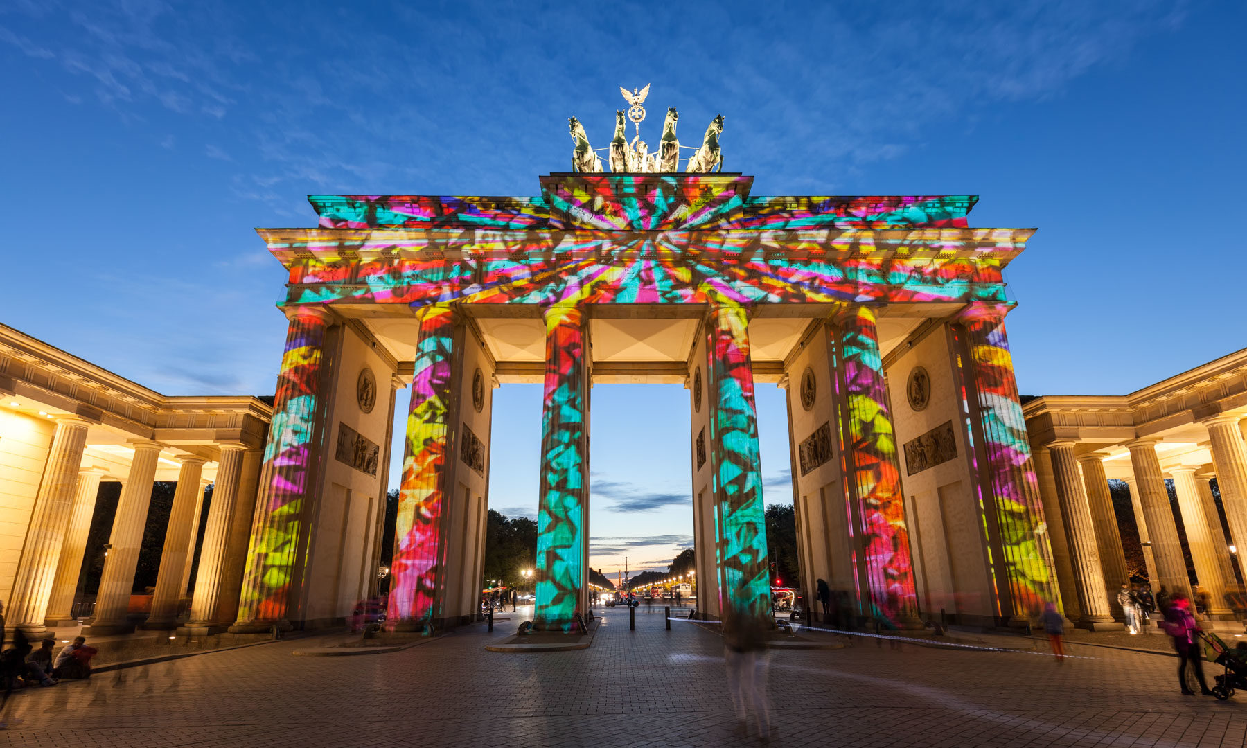
Berlin City Tour – Global Round Itinerary
Day 1 – Monday, October 5, 2026 📌 Welcome 🏨 Hotel Check-in
On the first day, delegations from all participating countries will arrive in Berlin. Students and team leaders will be transferred to the official ESO hotels and complete their registration process. The day will conclude with rest and preparation for the Opening Ceremony scheduled for the following day.

Slide 8

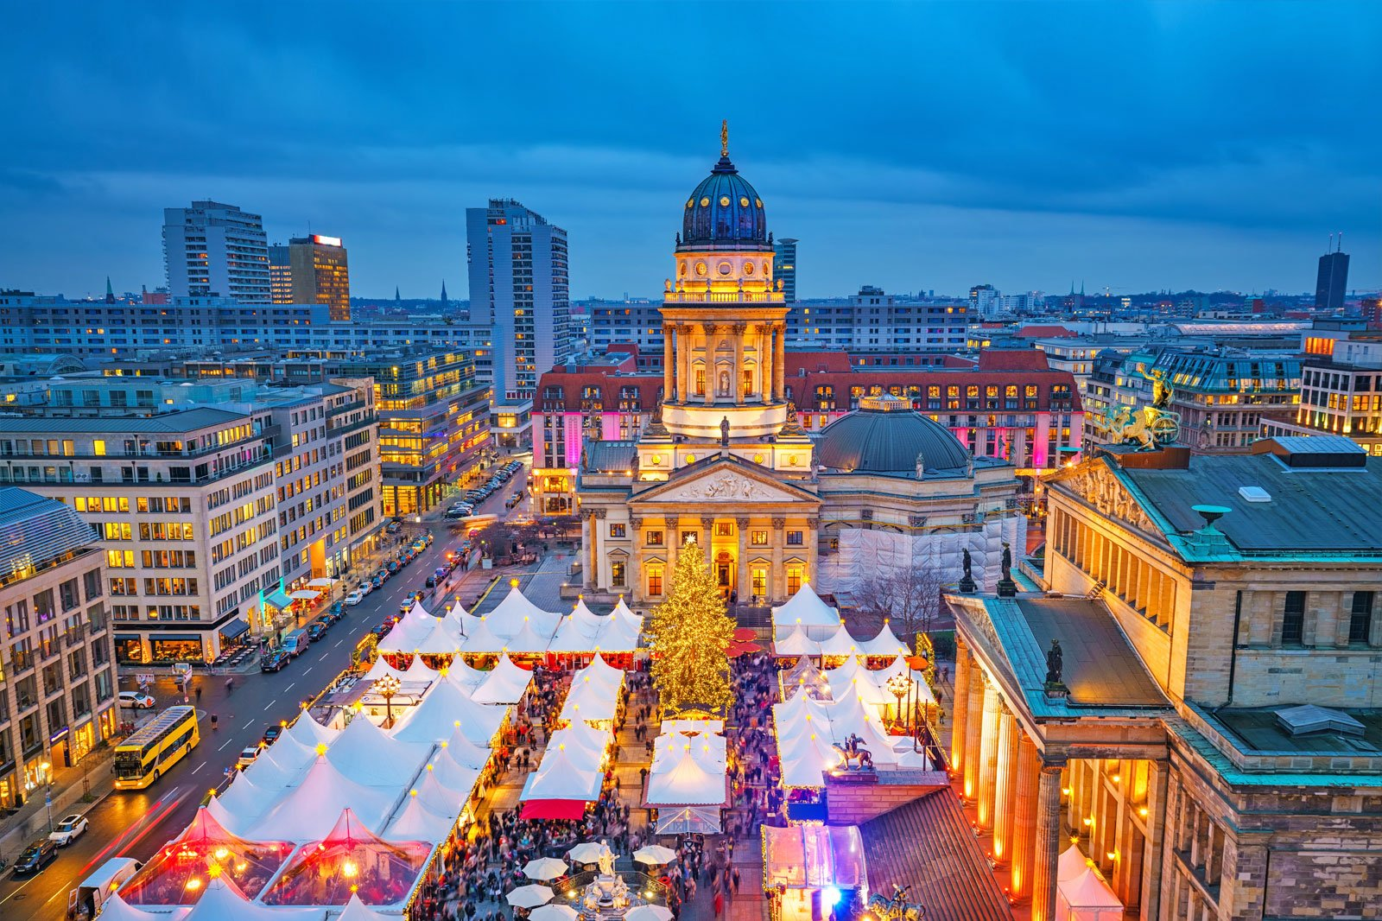
Day 2 – Monday, October 6, 2026 📌 Competition day
On the second day of the city tour, after breakfast, participants will explore one of Berlin’s most renowned cultural areas – the Museum Island, home to world-famous sites such as the Pergamon Museum, Neues Museum, and the Berliner Dom. Afterwards, the group will enjoy lunch by the Spree River. The afternoon continues with a visit to the Holocaust Memorial, followed by breathtaking views of the city from the dome of the Berlin Cathedral. The day concludes with a scenic boat tour along the Spree River, offering a unique perspective of Berlin’s landmarks.
Day 1 – Monday, October 7, 2026 📌 Prize distribution Day
The third day of the city tour begins with breakfast, followed by a visit to the world-famous East Side Gallery, where participants will see the iconic graffiti on the Berlin Wall. The tour then continues at Checkpoint Charlie, the symbolic border crossing point of the Cold War era. In the afternoon, students will explore the magnificent Charlottenburg Palace and its gardens, one of Berlin’s most beautiful historical sites. The day concludes with shopping and souvenir time along Kurfürstendamm, Berlin’s most vibrant shopping boulevard.

Slide 9

III. ADEPT (ACHIEVEMENT IN DIVERSE EDUCATIONAL PROGRESS AND TAELNT COMPETIONS OLYMPIADS)
Adept Olympiad Is An International Competition Designed To Recognize And Encourage Diverse Student Talents. It Offers Subjects Such As Mathematics, Science, English, Digital Technology, And Creative Thinking. Open To Students From Kindergarten To Secondary Levels, The Olympiad Aims To Promote Global-standard Learning, Problem-solving Skills, And Confidence Through Competitive Assessment And Recognition.

Slide 10
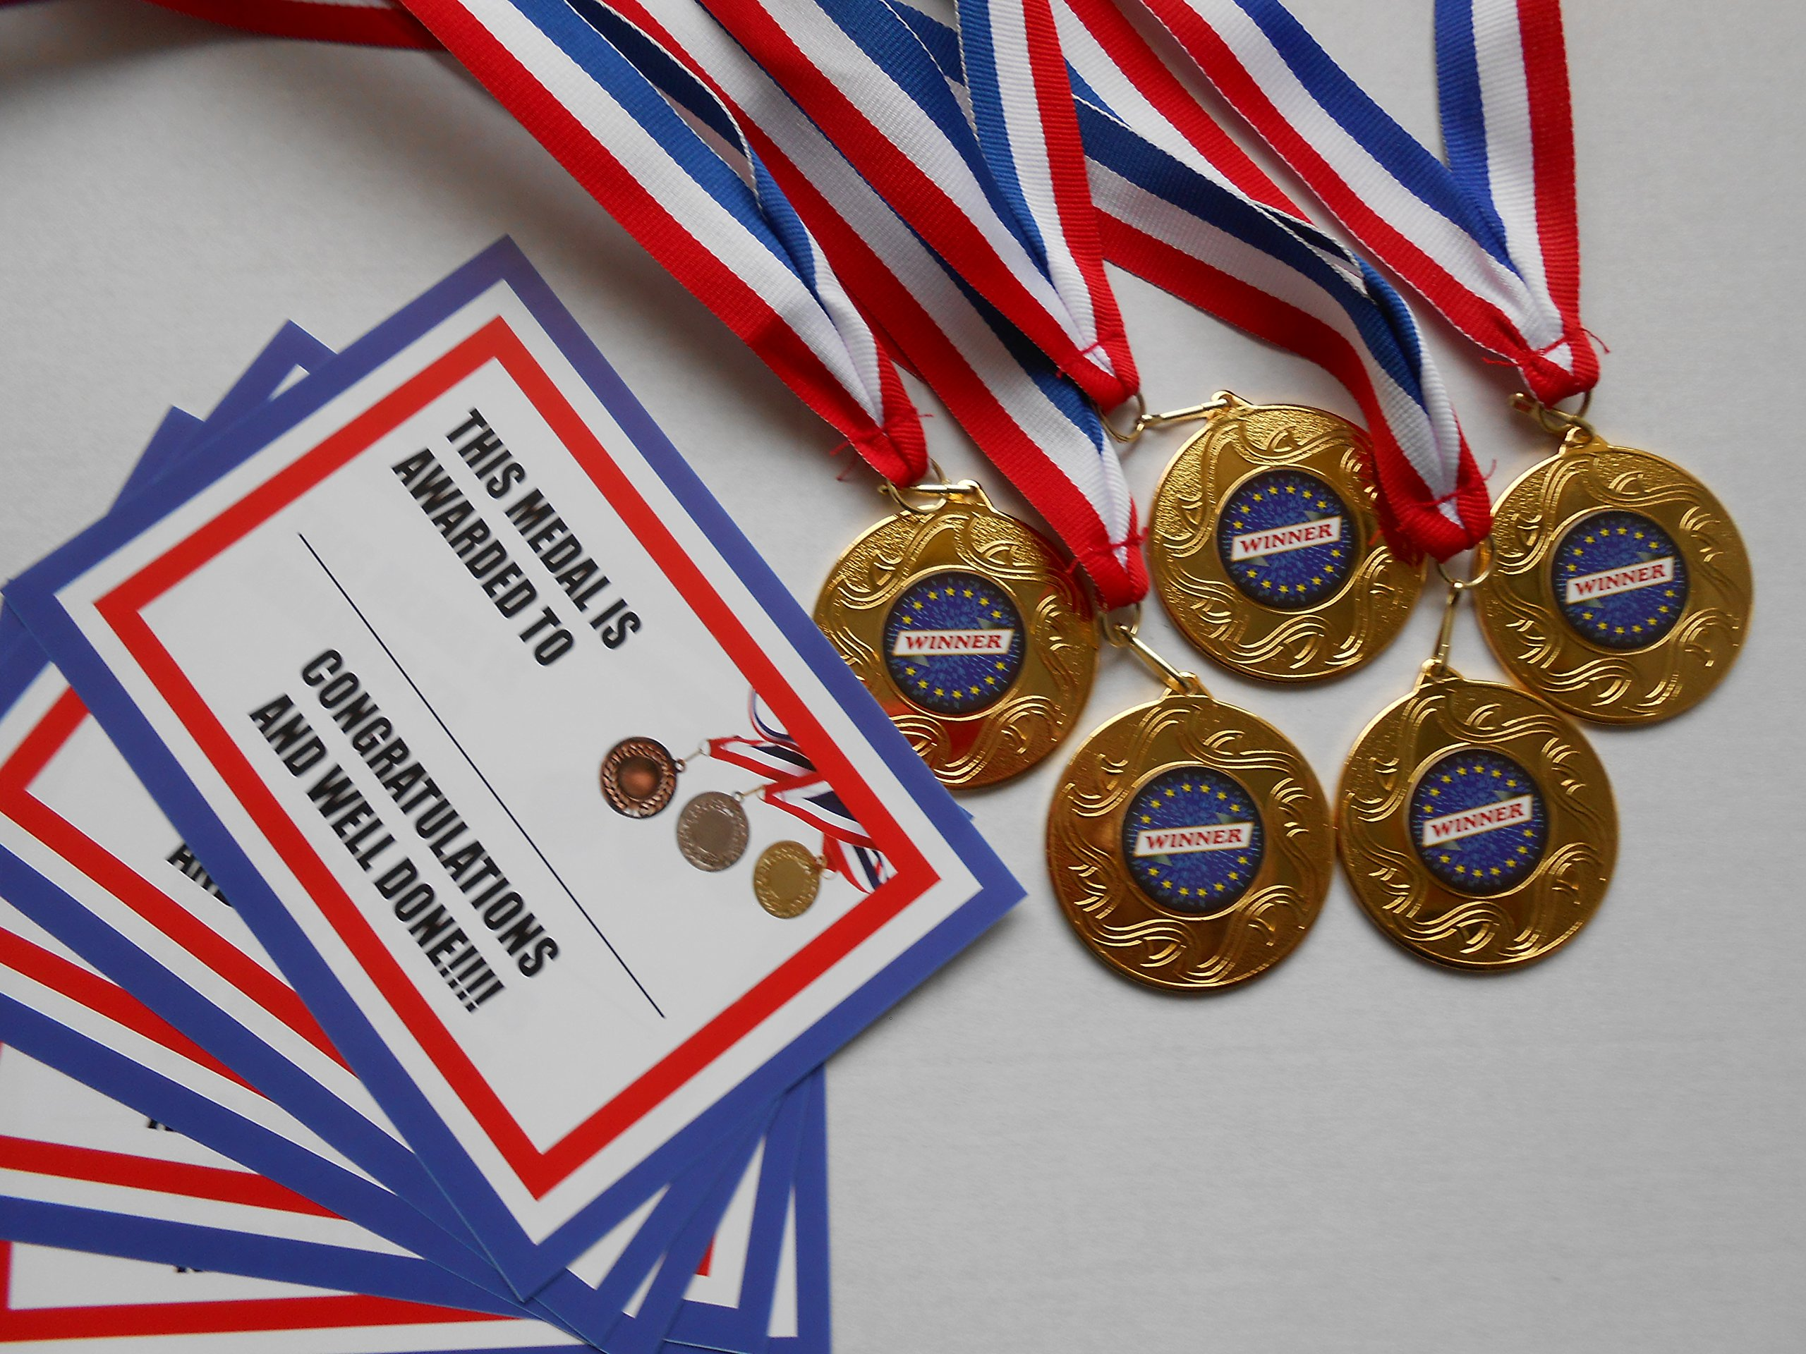
ADEPT - OVERVIEW
Competition | Grade | No of questions | Duration (Minutes) | Marking Scheme | Total Marks | Negative Marking | Competition Date | Registration fee
ADEPT | KG -12th grade | Kinder garden- 15 Grade 1 and 2- 20 Grade 3 and 4 – 25 Grade 5-12 - 30 | Kinder garden- 30 Grade 1 and 2- 40 Grade 3 and 4 – 45 Grade 5-12 - 50 | +4 for correct, 0 for wrong, -1 for unanswered question | Kinder garden- 40 Grade 1 and 2- 80 Grade 3 and 4 – 100 Grade 5-12 – 50- 120 | -1 | 2nd May 2026 | 650/-INR
All participants will receive an e-certificate in the national round.
● To encourage the support and assistance of teachers, schools, and coordinators, each
school and coordinator will receive an e-certificate.
● Achievement Excellence Award, Outstanding Award, Gold, Silver, Bronze, and Merit
ADEPT National round winners will be invited to participate in ADEPT Global round 2026.
● Each grade level/ competition level/ category should have an excess 100 entries.

Slide 11
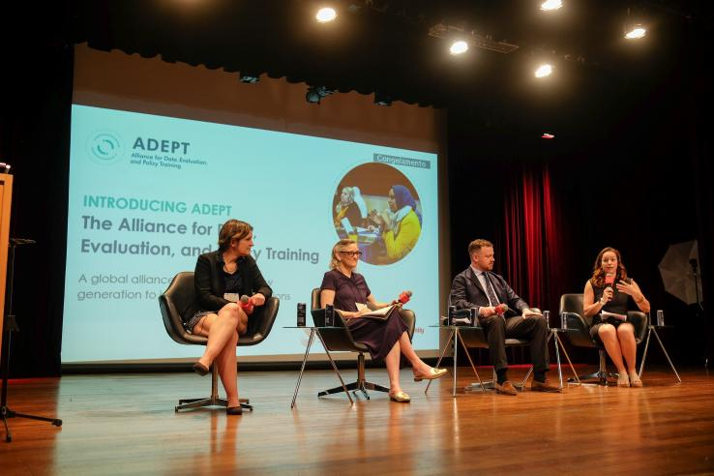
GLOBAL ROUND - OVERVIEW
Competition | Grade | No of questions | Duration (Minutes) | Marking Scheme | Total Marks | Negative Marking | Competition Date
ADEPT- Global round | KG-12th grade | 15 questions for Kinder garden 30 questions from grade 1-12 | 30 minutes for kinder garden 50 minutes for grade 1-12 | +4 for correct, 0 for wrong, | 100 | -1 | 24th- 27th of July, 2026
Premier Achiever Award: Top scorer / 100 marks
Rising Star Achiever: 95–99
Gold Award: 90–94
Silver Award: 80–89
Bronze Award: 70–79
Merit Award: 60–69
Participation Certificate: Below 60

Slide 12

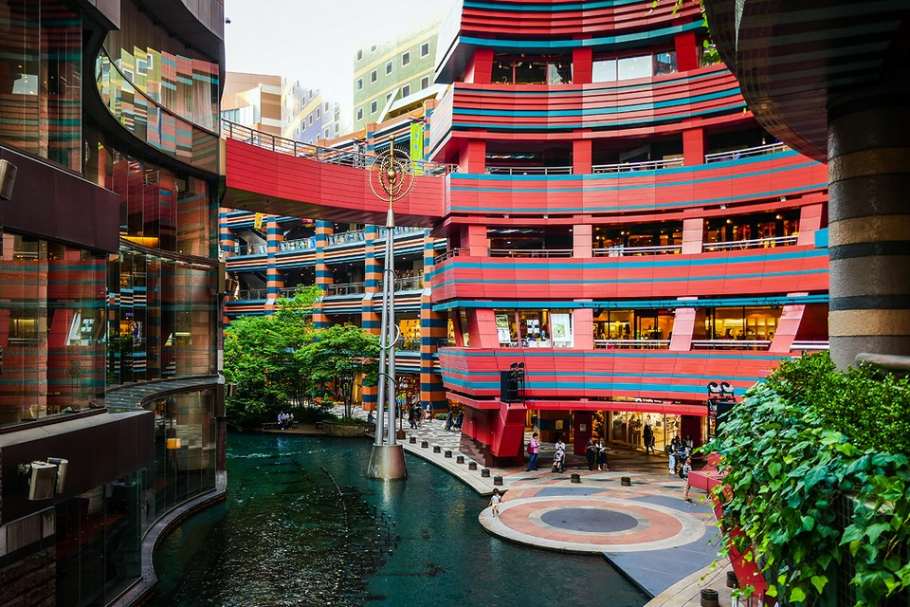
Fukuoka City Tour – Global Round Itinerary
🔹 Day 1 — 24 July 2026
✈️ Arrival in Fukuoka, hotel check-in and 🤝 Welcome & Networking Gala.
🔹 Day 2 — 25 July 2026
🎤 Opening Ceremony followed by 🏙️ City Tour including Canal City Hakata and 🍽️ Lunch Buffet.

Slide 13
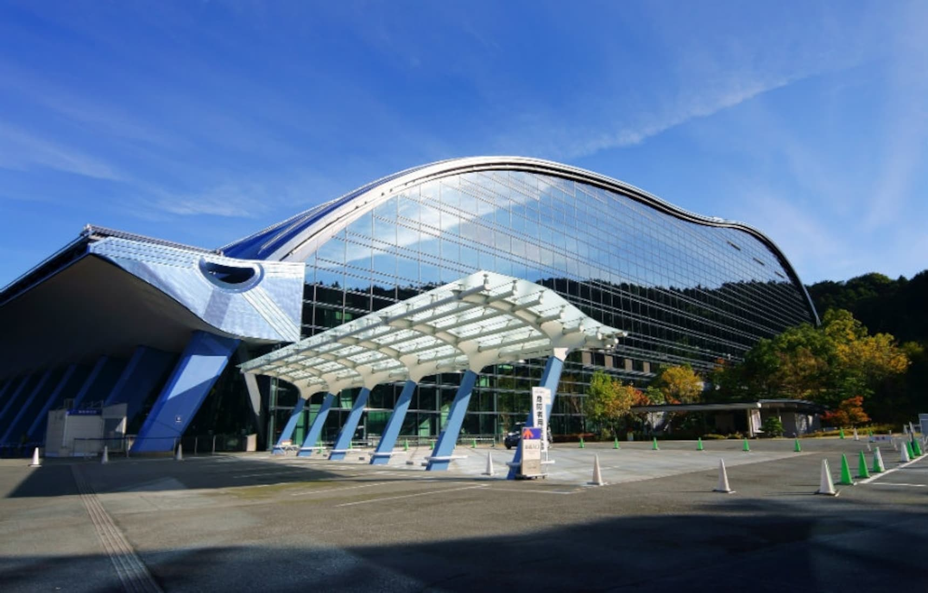

🔹 Day 3 — 26 July 2026
🧠 Competition Day with 🍱 Lunch Buffet and visit to 🏛 Kyushu National Museum.
🔹 Day 4 — 27 July 2026
🏆 Award Ceremony followed by 🚄 departure.

Slide 14

IV. TIMO(Turkic International Math Olympiad)
The Turkic International Mathematical Olympiad (TIMO) is an international math competition for students from Grade 2 to Grade 12. It aims to enhance students’ analytical thinking, logical reasoning, and problem-solving skills through challenging and creative math questions. TIMO is conducted in two stages — a Preliminary Round held in participating countries and a Global Round hosted in Turkey. Students who perform well receive International Merit awards and participation awards. TIMO provides global exposure, builds confidence, and encourages students to pursue excellence in mathematics.

Slide 15
TIMO - OVERVIEW
Competition | Grade | No of questions | Duration (Minutes) | Marking Scheme | Total Marks | Negative Marking | Competition Date | Registration fee
TIMO | 2nd -12th grade | Grade 2nd -4th – 20 questions Grade 5th -12th – 25 questions | Grade 2nd 4th – 60 minutes Grade 5th -12th – 90 minutes | +4 for correct, 0 for wrong, -1 for unanswered question | Grade 2nd – 4th – 80 Grade 5th -12th - 100 | -1 | February 15th 2026 | 650/-INR
Awards and Certificate
1. Participation certificates
2. Merit Certificate
3. Distinction certificate
4. Honor Roll certificates

Slide 16
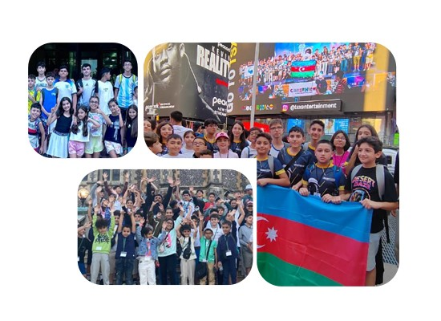
TIMO – GLOBAL ROUND OVERVIEW
Competition | Grade | No of questions | Duration (Minutes) | Marking Scheme | Total Marks | Negative Marking | Competition Date
TIMO Olympiad- Global round | 2nd -12th grade | 25 | 90 | +4 for correct, 0 for wrong, 0 for unanswered question | 100 | -1 | 24TH -28th of May 2026
Final Round: Medals awarded based on percentile performance (e.g., Top 8% Gold, Top 15% Silver) Special trophies/prizes may be awarded depending on yearly guidelines

Slide 17
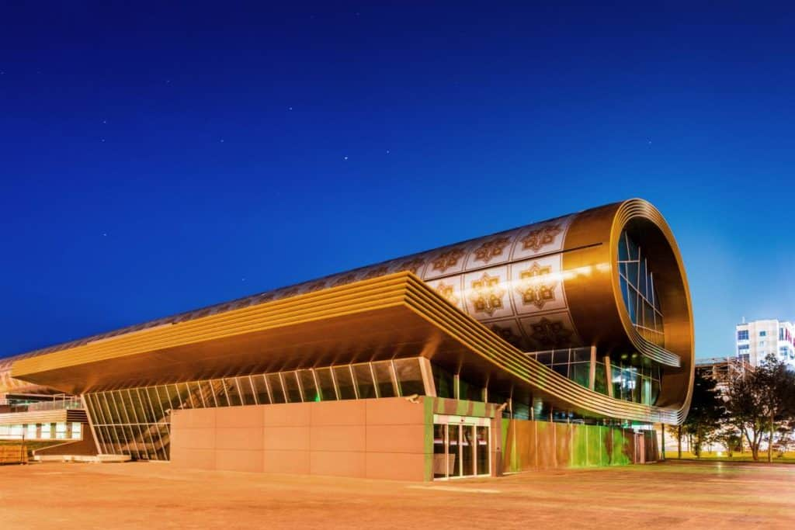
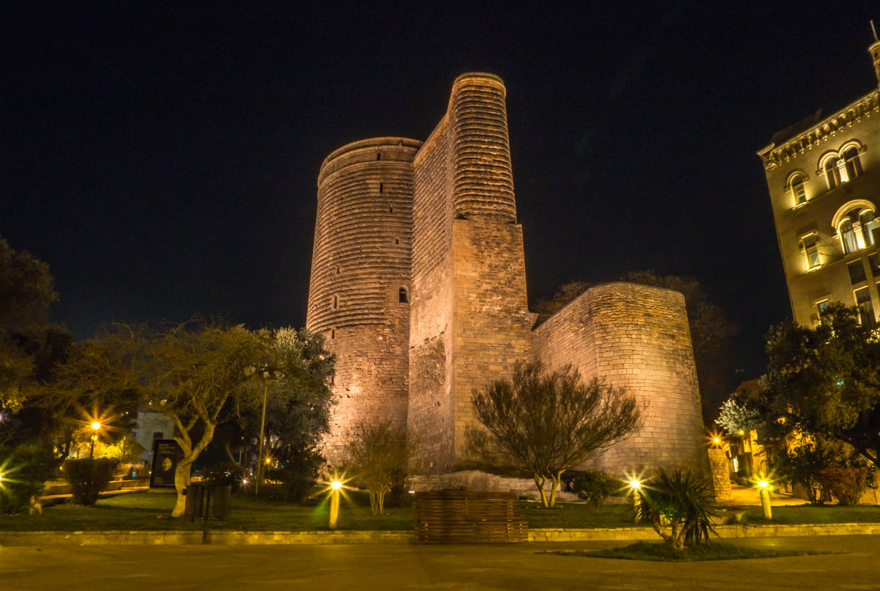
BAKU CITY TOUR - Global Round Itinerary
Day 1 – 24 May 2026 | Arrival & Registration
Check-In & Registration (14:00–21:00)
Hotel Check-In
Dinner
Day 2 – 25 May 2026 | Opening Ceremony & City Tour
Breakfast
Opening Ceremony
City Tour: İçərişəhər (Old City), Miniature Book Museum, Maiden Tower, Carpet Museum, History Museum
Dinner

Slide 18
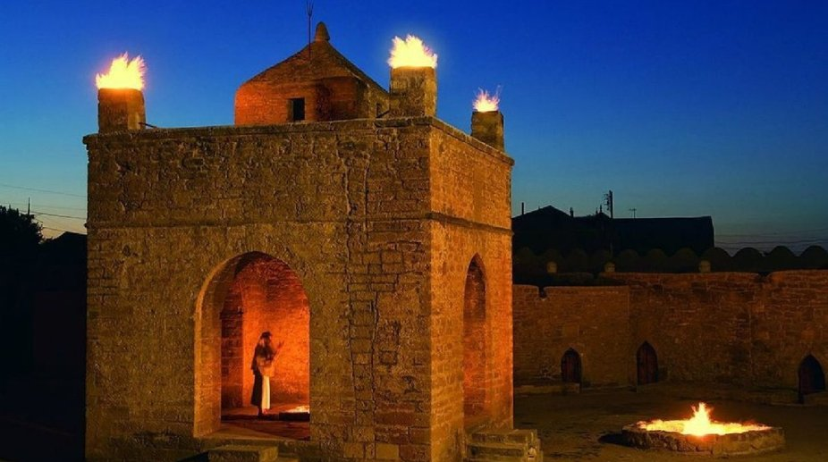
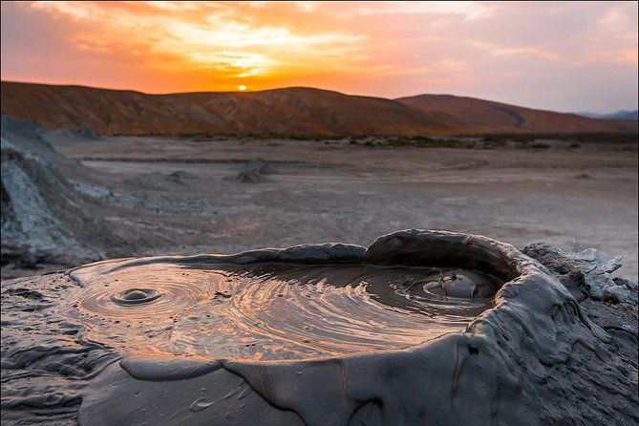
Day 3 – 26 May 2026 | TIMO Exam & Historical Sites
Breakfast
TIMO Exam
Visit: Atashgah Temple, Yanar Dağ (Fire Mountain), Mountain Park
Dinner
IB Meeting at Hotel
Day 4 – 27 May 2026 | Awards & Excursion
Breakfast
Gobustan & Mud Volcano Tour
Award Ceremony
Flag Square Visit
Day 5 – 28 May 2026 | Departure
Breakfast
Transfer to Airport & Return Home

Slide 19

V. SIN PHYSICS
The Sir Isaac Newton (SIN) Physics Exam, conducted by the University of Waterloo, Canada, is an internationally recognized physics contest for high school students. It challenges students’ conceptual understanding, logical reasoning, and problem-solving skills in physics through thought-provoking multiple-choice questions. The exam encourages curiosity and deeper learning in physics and provides global academic recognition, making it valuable for students interested in STEM and physics-related careers.

Slide 20


SIN PHYSICS- COMPETITION OVERVIEW
Competition | Grade | No of questions | Duration (Minutes) | Marking Scheme | Total Marks | Negative Marking | Competition Date | Registration fee
SIN PHYSICS | 9th -11nth grade | 12 | 120 | +4 for correct, 0 for wrong, 0 for unanswered question | 48 | 0 | May 1st 2026 | 900/-INR
📜 Certificates
Participation Certificate
Given to students who appear for the SIN exam.
Issued through the school / exam coordinator.
Confirms participation in a University of Waterloo international physics contest.
Achievement / Merit Recognition
High-scoring students may receive achievement recognition (such as distinction or top-percentage mention).
The exact category depends on year-wise performance cut-offs.
Recognition is based on global performance, not just school level.

Slide 21
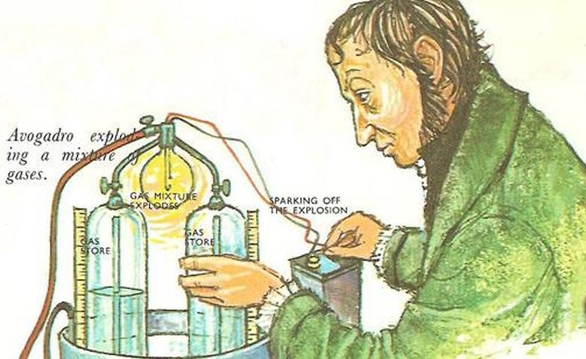
VI. AVOGADRO CHEMISTRY
The Avogadro Chemistry Contest, organized by the University of Waterloo, is an international chemistry competition designed primarily for Grade 11 students. The contest tests students’ understanding of fundamental chemistry concepts, analytical thinking, and application-based problem solving through multiple-choice questions. It helps students strengthen their chemistry foundation and offers international academic recognition that supports future science and university applications.

Slide 22


AVOGADRO CHEMISTRY- EXAM OVERVIEW
Competition | Grade | No of questions | Duration (Minutes) | Marking Scheme | Total Marks | Negative Marking | Competition Date | Registration fee
Avogadro chemistry | 9th -11nth grade | 40 | 75 | +1 for correct, 0 for wrong, -0.25 for unanswered question | 40 | -0.25 | May 14TH 2026 | 900/-INR
🏆 3. Awards & Recognition
Recognition for Top Performance
Students with very high scores receive special recognition from Waterloo (national/global ranking or distinction).
Limited-Edition Plaques / Academic Awards
Some schools or regions may also give plaques or school awards for top scorers. (Often tied to top percentile performance.)

Slide 23

VII. NATIONAL BIOLOGY COMPETITION
The National Biology Competition (NBC), organized by the University of Toronto, is a prestigious international biology contest for high school students that assesses their understanding of core biological concepts, analytical thinking, and application-based problem-solving. It encourages scientific curiosity and excellence in life sciences and is widely recognized for its academic value in preparing students for future studies in biology, medicine, and related STEM fields.

Slide 24

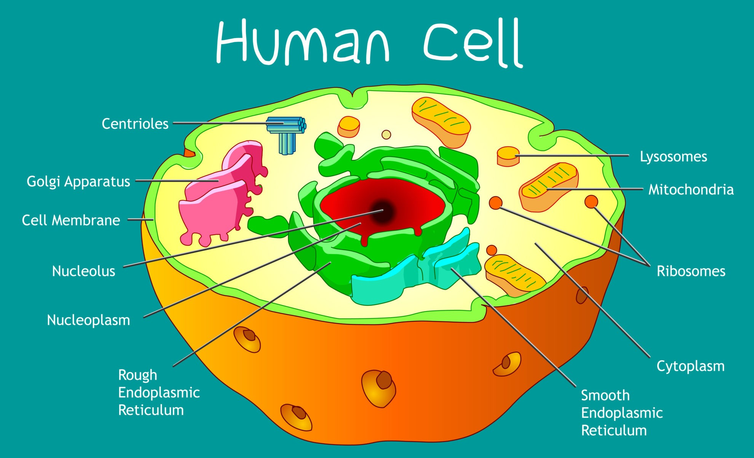
NBC- EXAM OVERVIEW
Competition | Grade | No of questions | Duration (Minutes) | Marking Scheme | Total Marks | Negative Marking | Competition Date | Registration fee
National Biology Competition | 9th -12th grade | 50 | 75 | +1 for correct, 0 for wrong | 50 | 0 | April 9th 2026 | 900/-INR
🏆 Certificates & Awards
Certificate of Participation
Given to all students who appear for the exam.
Certificate of Distinction
Awarded to top-performing students (usually top national or international percentiles).
Medals & Special Recognition
Gold, Silver, and Bronze medals awarded to top Canadian students.
High scorers may be placed on the National Honour Roll.

Slide 25
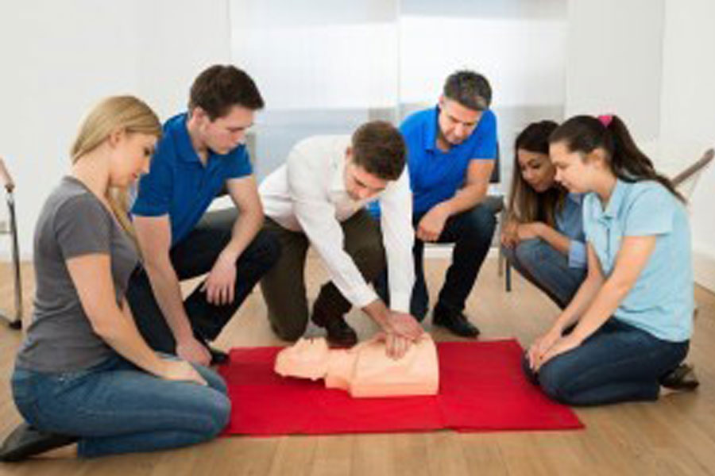

VIII. FIRST AID AND CPR TRAINING SESSIONS
Mode: Instructor-led training with practical assessment
Duration & Audience: Customized sessions for grades 7 to 12, each spanning 1.5 hours. Batch Size & Cost: Training in groups of 25 students, priced at 500 INR Blended Learning Environment: Integrating classroom sessions with online components for a comprehensive learning experience. Hands-On Training: Practical skills, including CPR, demonstrated, practiced, and evaluated under teacher supervision.
Format: Demonstration, supervised practice, and evaluation
Outcome: Participation certificate followed by full accreditation process

Slide 26
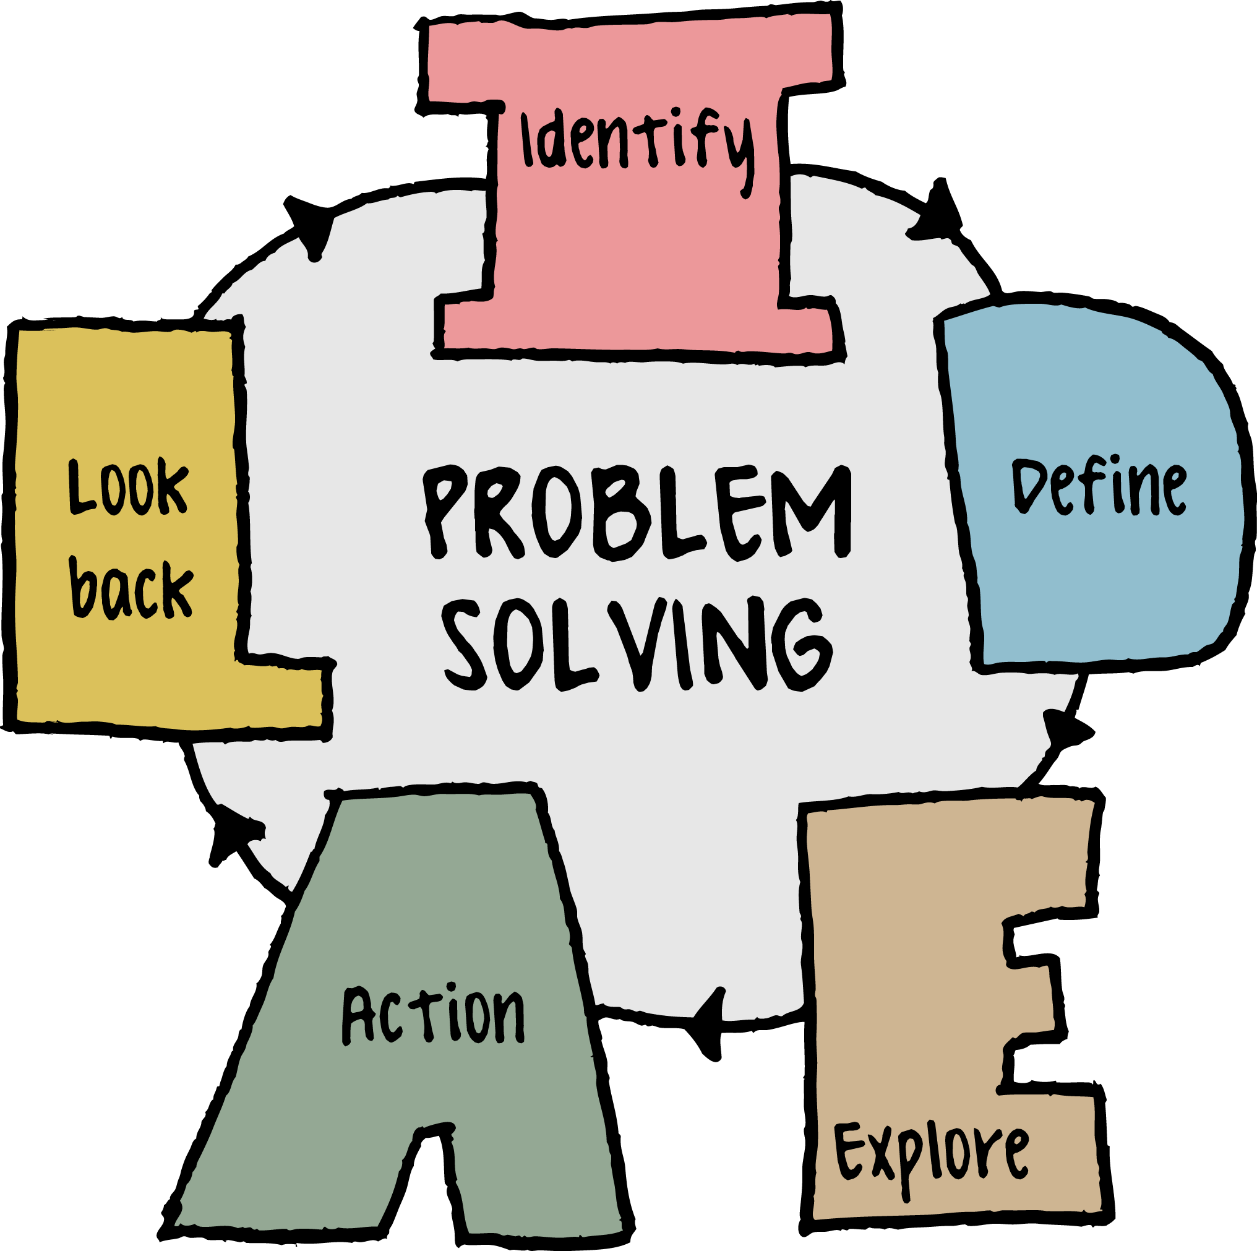


How TLUPS India Supports Students in Preparation & Training
Weekly competition-focused problem-solving seminars designed to build accuracy, strategy, and time management skills across exams such as ADEPT, Einstein Olympiad, TIMO, AMC 8, and international science competitions.
Competition-specific full-length mock examinations aligned with international exam patterns, supported by detailed performance analysis and personalized feedback.
Access to curated past papers, model questions, and topic-wise practice sets, including exposure to previous global-round level questions.
Monthly orientation and concept-discussion sessions covering exam structure, scoring systems, progression to global rounds, and comprehensive doubt-clearing for students and parents.
Digital learning support through e-books, structured study guides, and self-paced practice resources, customized for each competition.
Advanced training sessions led by authorized and accredited experts, including global-round readiness programs and exposure to international teaching and assessment standards.

Slide 27



Student Benefits of Participating in International Competitions & Global Rounds
Strengthens conceptual understanding beyond the school curriculum while developing advanced problem-solving, logical reasoning, analytical thinking, and creativity.
Helps in University applications to get admissions in global universities
Provides exposure to international-level question standards and assessment patterns, building a strong foundation for future competitive exams and Olympiads.
Offers participation certificates, merit recognitions, and global-round qualifications that enhance student profiles for international universities and programs.
Enables global benchmarking by competing with students from multiple countries and experiencing diverse academic and cultural environments.
Builds confidence, resilience, discipline, time-management, leadership, teamwork, and communication skills through structured competition exposure and independent thinking.

Slide 28
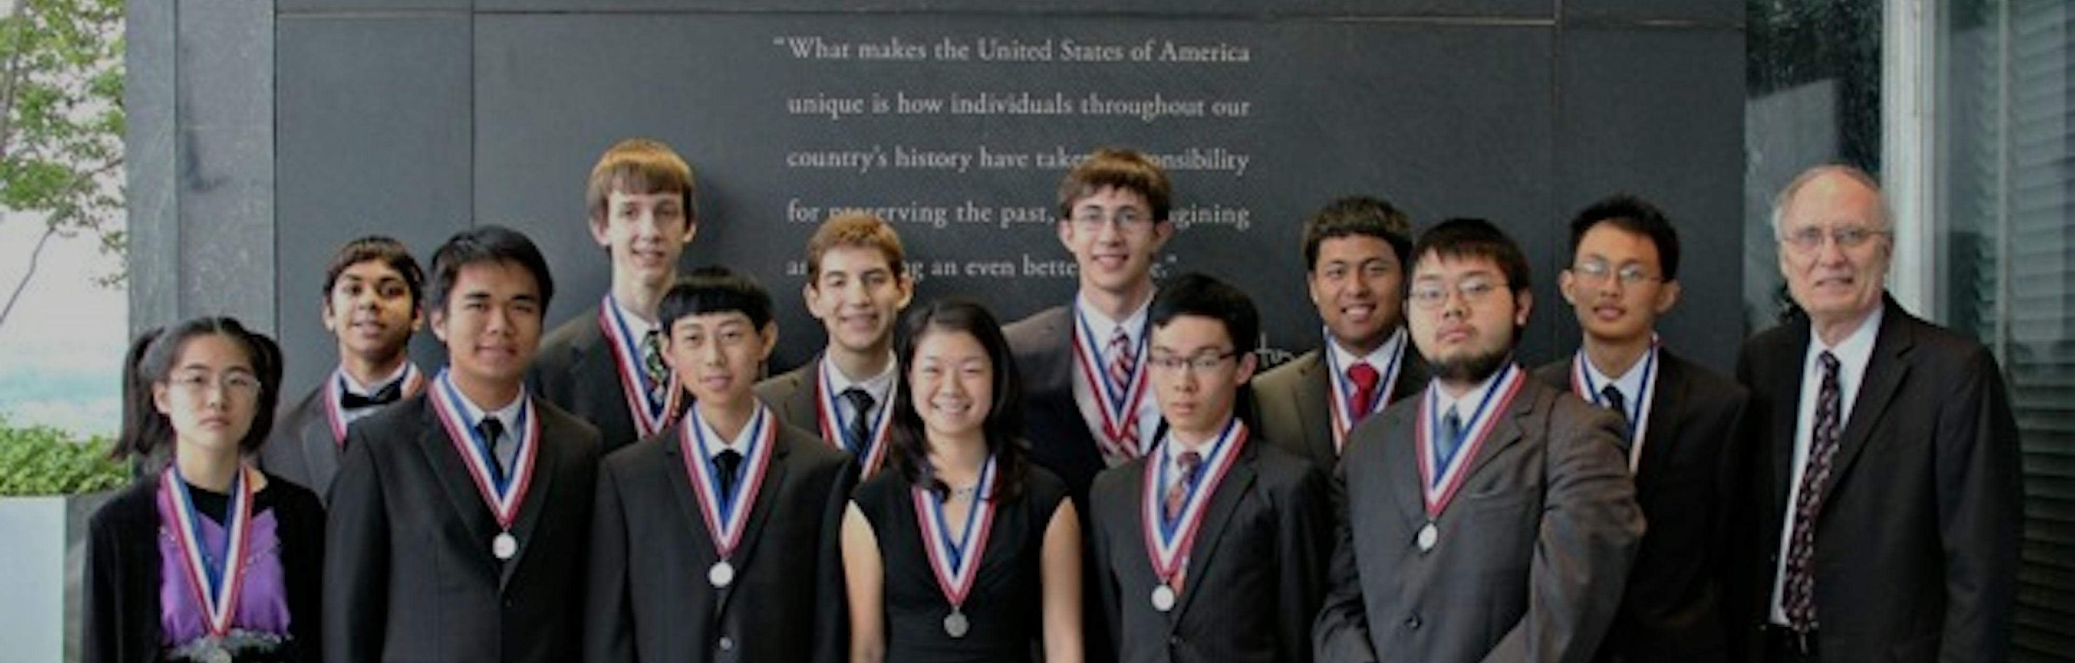
ARE YOU AIMING FOR THE GLOBAL ROUND?
Join our Small Group Preparation Course designed to help you train strategically, practice effectively, and qualify with confidence.
Focus on concept-based problem solving, not just practice
Assignments after every class with submission deadline
Assignment reports shared with parents
Mock test after every 3 sessions to track progress
Regular parent meetings for performance updates
Small group (10–12 students) for personal attention
Access to past papers, e-books & reading material before sessions
Course Completion Certificate from TLUPS India

